Slide 1
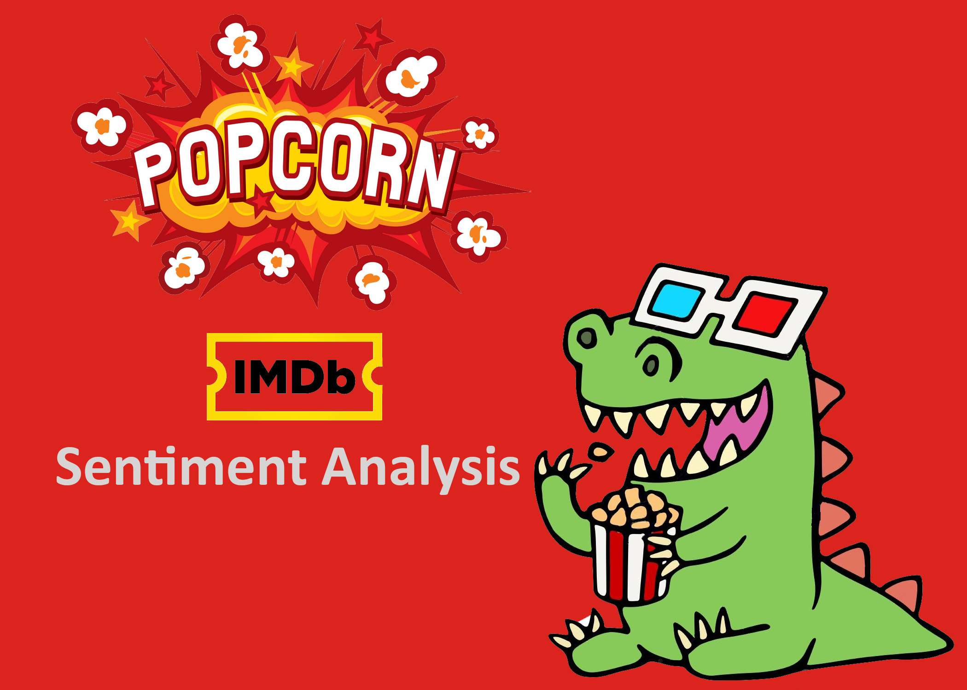

Slide 2

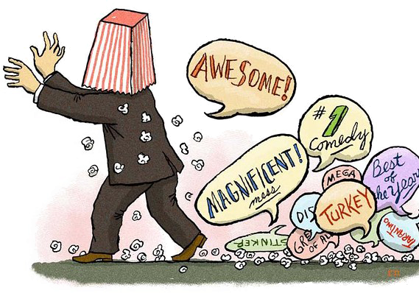
What are we working on: The problem to be addressed!
Mediocre movie
Mega disaster
Movie not fantastic

Slide 3
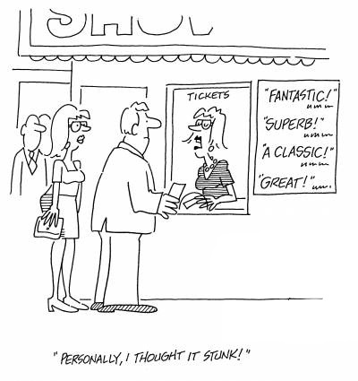
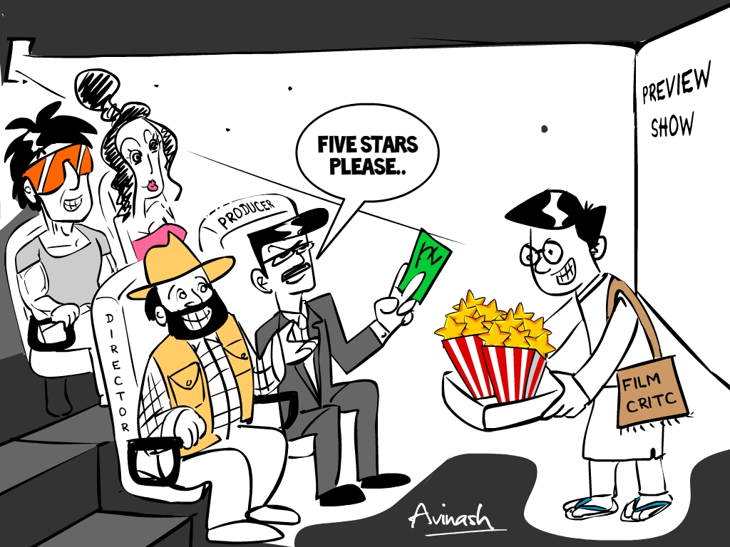
Why is it interesting?
• 81% of Internet users (or 60% of Americans) have done online research on a product at least once.
• 20% (15% of all Americans) do so on a typical day.
• consumers report being willing to pay from 20% to 99% more for a 5-star-rated item than a 4-star-rated item (the variance stems from what type of item or service is considered).

Slide 4
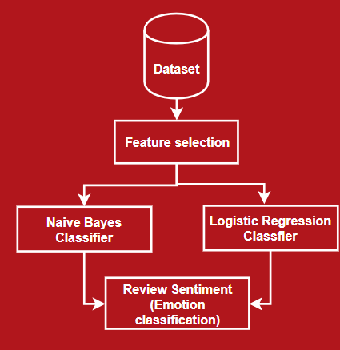
Approach
Feature Selection
  Remove over-frequent words
  Remove under frequent words
  Bi-gram combinations
Classifiers
  Naïve Bayes
  Logistic Regression
  Review sentiment
    Positive/Negative
    Emotions: happy, sad, angry,
    disappointed etc.

Slide 5
EVALUATION
Using two different algorithms for the two classifications.
Sentiment classification: Naive Bayes and Regularized Logistic Regression.
Emotion Classification: Naive Bayes and Elastic Net algorithms.

Slide 6
EVALUATION
Our classifications will be evaluated on the training data available on Kaggle and Cornell University’s datasets
5-fold cross validation.
Validations include: Training and Testing data error measures, Precision, Recall, and F1.
F1 : Harmonic Mean of the precision and accuracy
Important in deciding the effectiveness of a classification.

